Slide 1
Home Automation using Packet Tracer
Ashutosh Pattanayak
17BCS3545
CSE IBM IS-1

Slide 2
What is home automation?
Home automation gives you access to control devices in your home from a mobile device anywhere in the world. The term may be used for isolated programmable devices, like thermostats and sprinkler systems, but home automation more accurately describes homes in which nearly everything — lights, appliances, electrical outlets, heating and cooling systems — are hooked up to a remotely controllable network. From a home security perspective, this also includes your alarm system, and all of the doors, windows, locks, smoke detectors, surveillance cameras and any other sensors that are linked to it.

Slide 3
Why do we need it?
To remotely control home appliances and monitor them.
To save time and utilize the energy efficiently
To increase your independence and achieve greater control of home environment
To make it easier to communicate with family
To improve personal safety
To alert visually to emergency situations

Slide 4
Project Introduction
Homes of the 21st century will become more and more self-controlled and automated due to the comfort it provides, especially when employed in a private home. A home automation system is a means that allow users to control electric appliances of varying kind. Many existing, well-established home automation systems are based on wired communication. This does not pose a problem until the system is planned well in advance and installed during the physical construction of the building. But for already existing buildings the implementation cost goes very high.
In contrast, Wireless systems can be of great help for automation systems. With the advancement of wireless technologies such as Wi-Fi, cloud networks in the recent past, wireless systems are used every day and everywhere.

Slide 5
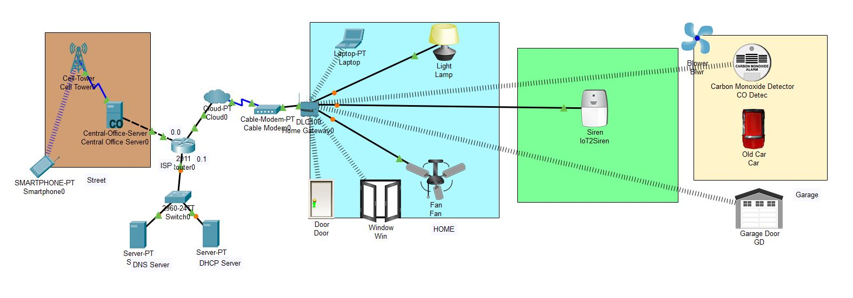
Project Design

Slide 6
Cisco Packet Tracer
Packet Tracer is a cross-platform visual simulation tool designed by Cisco Systems that allows users to create network topologies and imitate modern computer networks. The software allows users to simulate the configuration of Cisco routers and switches using a simulated command line interface. Currently cisco released new version of packet tracer that includes:-
Offers a realistic simulation and visualization of IOT device
Permits users to design, build, configure smart home, smart city by providing different smart object used for them.
Provide board to control smart object
Allows students to explore concepts IOE
Provide detector for sensor

Slide 7
Project Working
Therefore after registering a smart phone to home gateway all devices are accessed through web by legitimate user. There are six IOE device registered to Home gateway those all are controlled through web by legitimate person.
Smartphone can be used anywhere till it has network connection to the remote server.
The smart object is connected to the home Gateway using Ethernet cable and wireless medium to manage smart device local and remotely. Home gateway also works as DHCP server by assigning IP address to each smart device that connected to it.

Slide 8
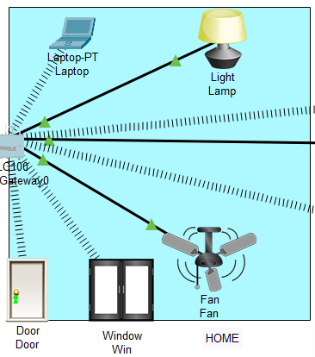
Home Area
Door can be opened and closed remotely
When enter through door light switches on automatically.
Window can be opened and closed remotely
When window is opened fan turns on low mode automatically.
Fan can be controlled remotely
Light brightness can be controlled.
Laptop can also be used to monitor and control all IOT devices

Slide 9
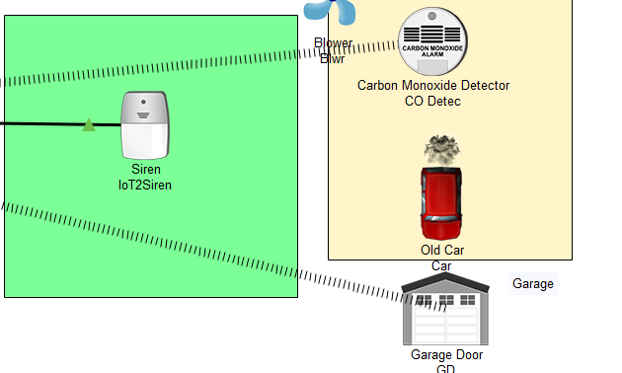
Garage Area
Garage can be opened and closed remotely.
Car if produces smoke CO detector can monitor it.
If CO level rises more than 0.05 then Siren is alerted
Also blower starts running

Slide 10
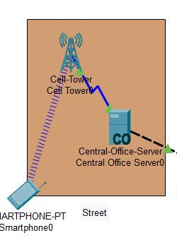
Street Area
A person can use his smartphone access IoT devices
Can use smartphone to control and monitor appliances
Can use smartphone to lock the doors and windows
Smart phone should be connected to cell tower

Slide 11
Advantages of home automation
1) Reduced installation costs: First and foremost, installation costs are significantly reduced since no cabling is necessary. Wired solutions require cabling, where material as well as the professional laying of cables (e.g. into walls) is expensive.
2) System scalability and easy extension: Deploying a wireless network is especially advantageous when, due to new or changed requirements, extension of the network is necessary. In contrast to wired installations, in which cabling extension is tedious. This makes wireless installations a seminal investment.
3) Aesthetical benefits: Apart from covering a larger area, this attribute helps to full aesthetical requirements as well. Examples include representative buildings with all-glass architecture and historical buildings where design or conservatory reasons do not allow laying of cables.
4) Integration of mobile devices: With wireless networks, associating mobile devices such as PDAs and Smartphones with the automation system becomes possible everywhere and at any time, as a device's exact physical location is no longer crucial for a connection (as long as the device is in reach of the network).

Slide 12
Conclusion
The home automation using Internet of Things has been experimentally proven to work satisfactorily by connecting simple appliances to it and the appliances were successfully controlled remotely through internet. The designed system not only monitors the sensor data, like temperature, gas, light, motion sensors, but also actuates a process according to the requirement, for example switching on the light when it gets dark. It also stores the sensor parameters in the webpage (database) in a timely manner. This will help the user to analyse the condition of various parameters in the home anytime anywhere

